Slide 1
Welcome to Back to School Night!
3rd Grade
MRS. PEREZ
Thank you for being here!

Slide 2
Regular Daily Schedule
School Begins | 7:50 | Report for Duty
 | 7:50-8:20 | Morning Business
 | 8:20-9:50 | MATH / (SMALL GROUP INSTRUCTION)
Recess | 9:50-10:03 | (Snack)
 | 10:03-11:00 | ELA (DIRECT INSTRUCTION)
Lunch | 11:00-11:40 | LUNCH
 | 11:40-1:35 | ELA (SMALL GROUP INSTRUCTION)
Recess | 1:35-1:48 | Recess
 | 1:48-2:30 | SOCIAL STUDIES/SCIENCE/PE
Dismissal | 2:30 | Dismissed

Slide 3
LANGUAGE ARTS
*READING LITERATURE – R.L.
Retell a story- Character, Setting, Plot, Sequence
Ask/Answer Questions- Who, What, Where, When, Why, How
Compare/Contrast - two versions of the same story
Understand Point of View- 1st person, 3rd person
*READING INFORMATIONAL TEXT- R.I.
Ask/Answer Questions with Details
Identify Main Idea and Retell Key Details
Compare/Contrast two texts on the same topic
*STATE TEXTUAL EVIDENCE- On page ___, it said …
*FLUENCY- ability to read grade level texts easily
Common Core: http://www.cde.ca.gov/re/cc

Slide 4
Math
PLACE VALUE: Hundreds, Tens, and Ones
ROUNDING by 10s & 100s
ADD & SUBTRACT 2 & 3 DIGIT NUMBERS
TWO-STEP REAL WORLD PROBLEMS
MEASUREMENTS & DATA:
-Bar graphs/Tally Charts/Pictographs
FRACTIONS
GEOMETRY:
-Area/ Perimeter/ Polygons
MULTIPLICATION & DIVISION
-Memorize Multiplication Facts to 12
Common Core: http://www.cde.ca.gov/re/cc

Slide 5
Writing
GENRES:
Informational
Opinion
Narrative
Prewrite, Draft, Revise, Edit, Publish, Present
Research and Writing Projects
Proper Capitalization, Punctuation, and Grammar
Prints Legibly
Spells grade level words appropriately
Cursive
Common Core: http://www.cde.ca.gov/re/cc

Slide 6
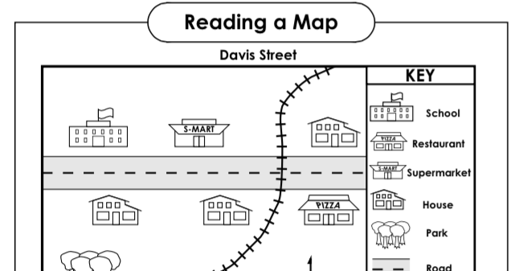
Science, Social Studies, Art
SOCIAL STUDIES: Geography, Biographies, American & California Indians, Government, Citizenship, Workers & Consumers
SCIENCE: How, Why, and What makes things work and live together. Hands-On Learning. Plant & Animal Life Cycles.
ART: Art Masters- Parent Volunteer Led

Slide 7
Accelerated Reader (AR)
Grade Level Goal – 36 pts
Tri. 1 - 12 pts
Tri. 2 - 12 pts
Tri. 3 - 12 pts
School – Wide Goal:
Medal – Top 3 Class Points Earners
Trophy – 80+ pts

Slide 8
Daily/Weekly Happenings
SPELLING TEST/READING COMPREHENSION TEST/VOCABULARY TEST
*Weekly Spelling Tests with an unseen dictation sentence
*Weekly Comprehension / Vocabulary Tests from Wonders Textbook.
Please help your child study their vocabulary words and read the story weekly.
A.R. – ACCELERATED READER
Weekly Comprehension Tests on their school library books in order to earn points. Library books will be in their Individual Reading Range.
*STUDENTS ARE EXPECTED TO READ 30 mins EVERY NIGHT.
FRIDAY FOLDERS
Sent home EVERY FRIDAY- review work, Check Behavior, AR Points, and Missing Assignments. Sign and Return empty EVERY MONDAY.
MATH FACTS
*STUDENTS ARE EXPECTED TO MEMORIZE MULTIPLICATION FACTS TO 12

Slide 9
AGENDAS/HOMEWORK/GRADING
AGENDAS
Students are responsible for copying down their homework. Families, please check here for which daily assignments are due.
*HOMEWORK IS ASSIGNED EVERY NIGHT (except Fridays) AND DUE THE NEXT MORNING.
GRADING RUBRIC
88 - 100 4-Extending the Standard
75 - 87 3-Achieving the Standard
60 - 74 2-Progressing with the Standard
0 - 59 1-Beginning with the Standard
Assessments (tests, quizzes, projects) - 60-75%
Assignments, class discussions, homework - 25-40%

Slide 10
Let's Talk About...
Homework | Don’t correct all of their work. It is good for us to see what they can do on their own.
Technology | All students will be assigned a chromebook for class use.
Behavior Consequences | Clip up/Clip down system, Fix-it Tickets, Office Referrals
Friday Folders | Please review and discuss the papers that come home. Sign and return every Monday.

Slide 11
Attendance
*Should your child begin to exhibit cold-like symptoms, please send them to school anyway. We have a Health Tech on staff everyday. They will assess your child’s symptoms and contact you if necessary.
*Makeup work policy- students will have the same number of days to complete work (i.e. if student is absent 3 days, they will have 3 school days to complete their absent work for full credit.)
School attendance is the #1 factor in school achievement!!

Slide 12
PBIS: School Wide/Classroom Expectations
*Be Safe
*Be Respectful
*Be Responsible
CONSEQUENCES:
1. Clip up/ Clip down
Fix It Ticket = Note Home
Office Referral
REWARDS:
Class party- when marble jar is filled up
E-Passes – a School-Wide reward system for prizes.
PTO Membership $15

Slide 13
Extras
BIRTHDAYS
If you are wanting to celebrate your child’s birthday, please notify me, at least one day in advance. All food items must be store bought.
HOLIDAY PARTIES
We are able to celebrate the holidays with a class party. Craft & food donations will be welcomed and appreciated. All food items must be store bought.
SPIRIT DAYS
Mondays –School Theme (Music Shirt)
Wednesdays –Class College Gear (ARMY West Point)
Fridays – Marshall spirit wear (Wear blue)

Slide 14
Contact Me
PARENT SQUARE is our new communication platform. Your messages are private and seen only by me, not the entire class.
Email:
erica_perez@chino.k12.ca.us
School Office Phone:
909) 627- 9741 Please leave a message with the office.

